Slide 1
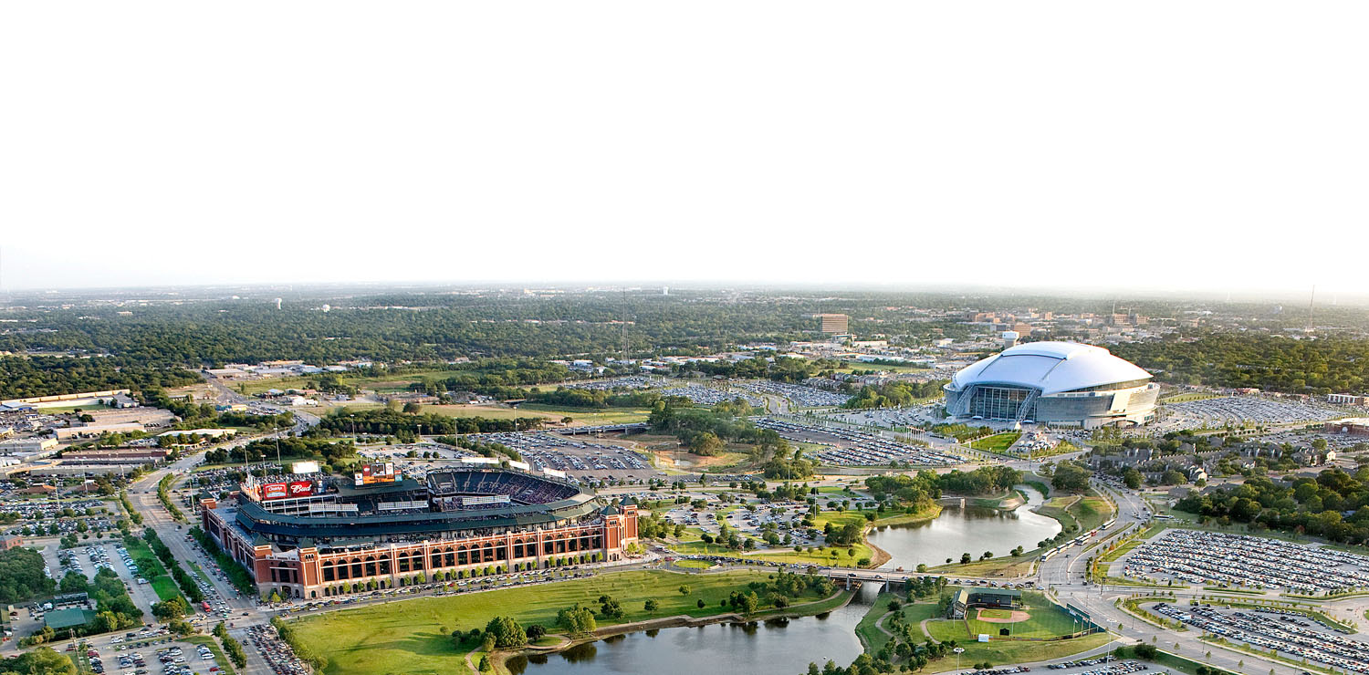

See It Through Charities, Inc
Organizational Overview & Program Initiatives Guide

Slide 2
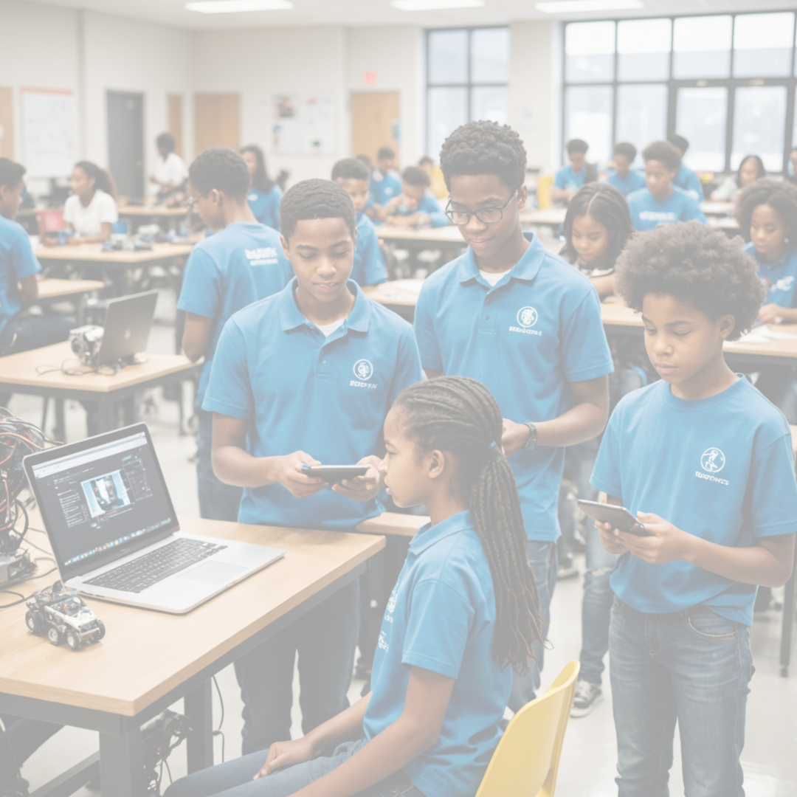





JANUARY 20XX
Table of Contents
About Us - 2
SITC Executive Board - 3
SITC Leadership Team - 4
Omega Gents - 5-6
STEM Academy - 7-8
Scholarships - 9
Fundraising - 10
https://seeitthru.org
https://www.facebook.com/SeeItThroughCharities/about/
Version 1 February 2025

Slide 3

ABOUT US
Vision Statement
To provide transformative educational opportunities that empower individuals in our community to achieve academic excellence, develop essential life skills, and unlock their full potential.
ORGANIZATION
See It Through Charities is a 501(c)(3) tax-exempt nonprofit organization, guided by our executive board and supported by a dedicated membership in the Dallas-Fort Worth metropolitan area.
SCHOLARSHIPS
Since 2017, we have awarded a total of $145,400 in scholarship funds. We believe in uplifting students for their challenging work by rewarding them with our Calvin Golden, Eddie B. Freeman, Merit-based and Omega Gents scholarships.
Mission
Our mission is to empower and uplift the next generation by providing access to education, guidance, and opportunities that cultivate leadership, academic excellence, and personal growth.
OMEGA GENTS
The Omicron Gamma Gamma Chapter (OGG) of Omega Psi Phi Fraternity, Inc. and the See It Through Charities Foundation collaboratively offer mentoring services through the “Omega Gents” Mentoring Program. Designed for young men ages 10-15, the program runs year-round in two terms.
STEM
The STEM Academy is designed for students ages 10 to 18, providing a structured curriculum in Science, Technology, Engineering, and Math (STEM). The program is crafted to engage students through hands-on learning, teamwork, and project-based applications to prepare them for careers in STEM fields.
2

Slide 4
SITC EXECUTIVE BOARD
Marcus Hall President
Dante’ Williams Vice President
Jared Foster-Smith Secretary
Ralph Pleasant Treasurer
3

Slide 5
SITC LEADERSHIP TEAM
David Farmer Omega Gents Chairman
Chad White
STEM Chairman
Jonathan Forna Scholarships Chairman
Geordan Lightfoot-Smith Fundraising Chairman
4

Slide 6
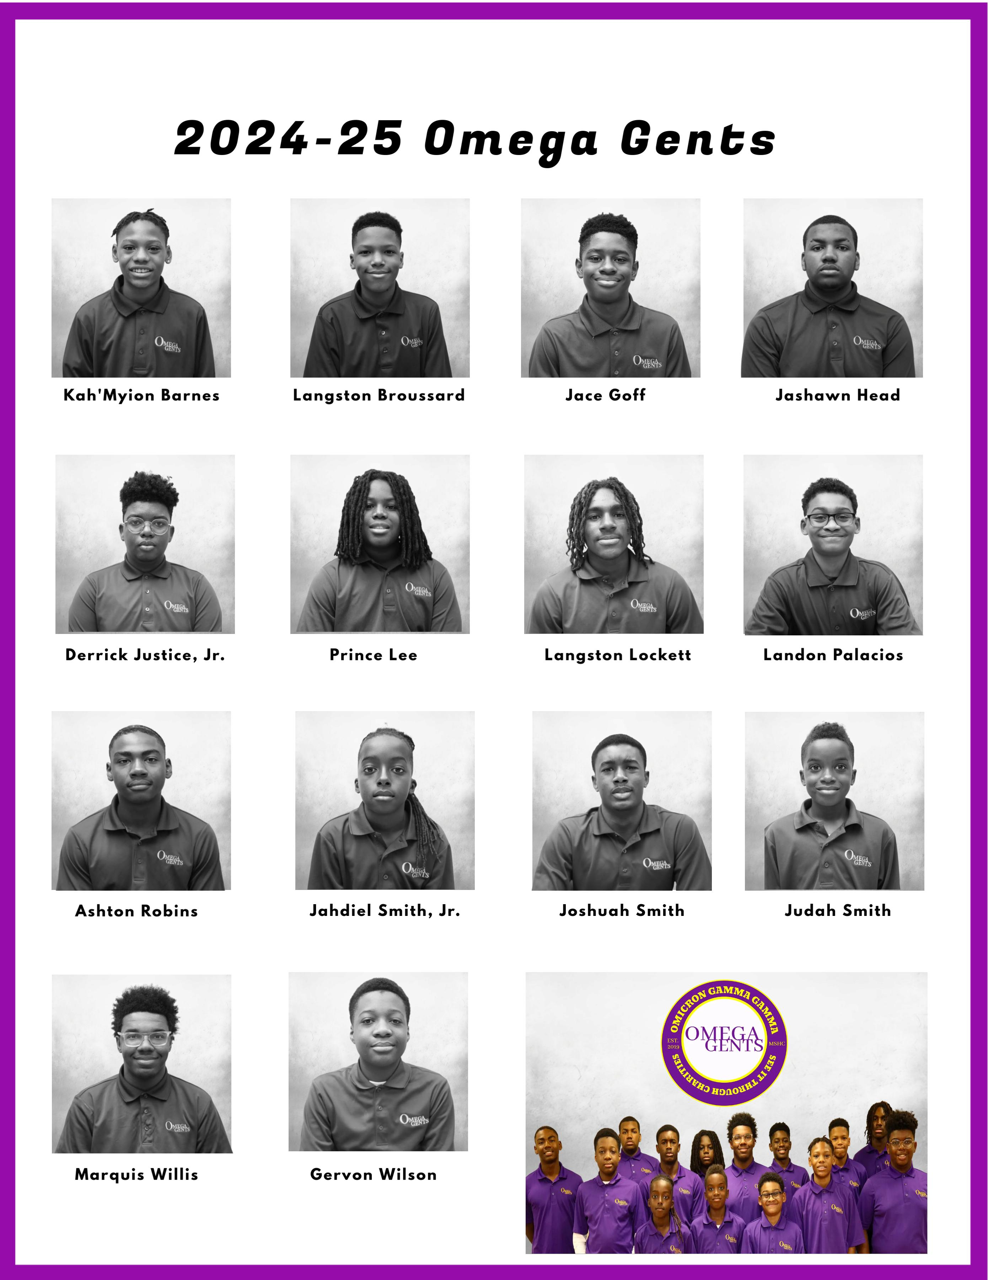
OMEGA GENTS
A Real Man is a Gentleman!
Mentoring Mission
The mission of the program is to establish a bonded relationship with young men by offering knowledge, support, and guidance. In addition, the program will teach basic principles involved with the transformation to manhood.
The Omicron Gamma Gamma Chapter (OGG) of Omega Psi Phi Fraternity, Inc. and the See It Through Charities Foundation jointly provide mentoring services through the “Omega Gents” Mentoring Program. The mentoring program accepts young men from ages 10-15 years of age and operates on yearly basis with two terms during the year. Applications for membership are accepted annually in April for an August start date.
The program focuses on four critical areas necessary for this successful transformation. Manhood, Scholarship, Health and Wellness, and Community/Social Involvement.
Our goals are to Focus on Gents’ interests, Focus on Mentors’ expertise, Be teachers not preachers, and Develop mentors as industry coaches for the Gents.
There are four program initiatives: the Omega Gents Podcast, First Impressions Program, Health, Wellness, and Technology Expo, and The Etiquette Experience.

Slide 7
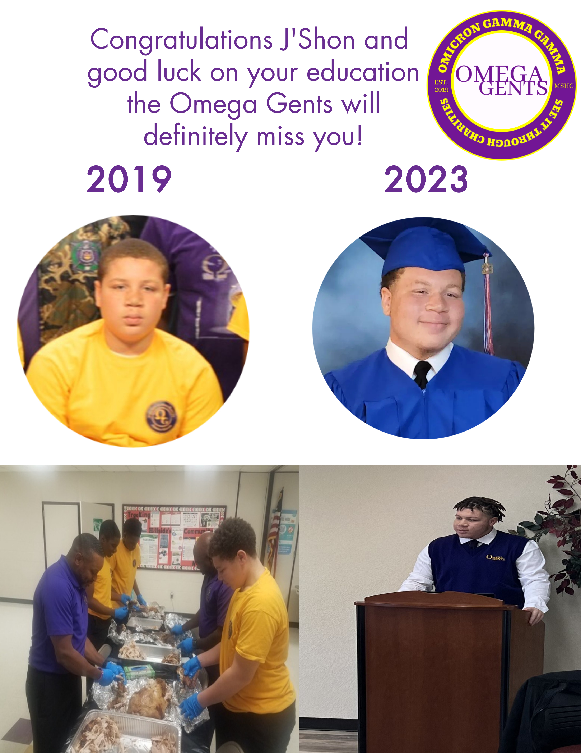
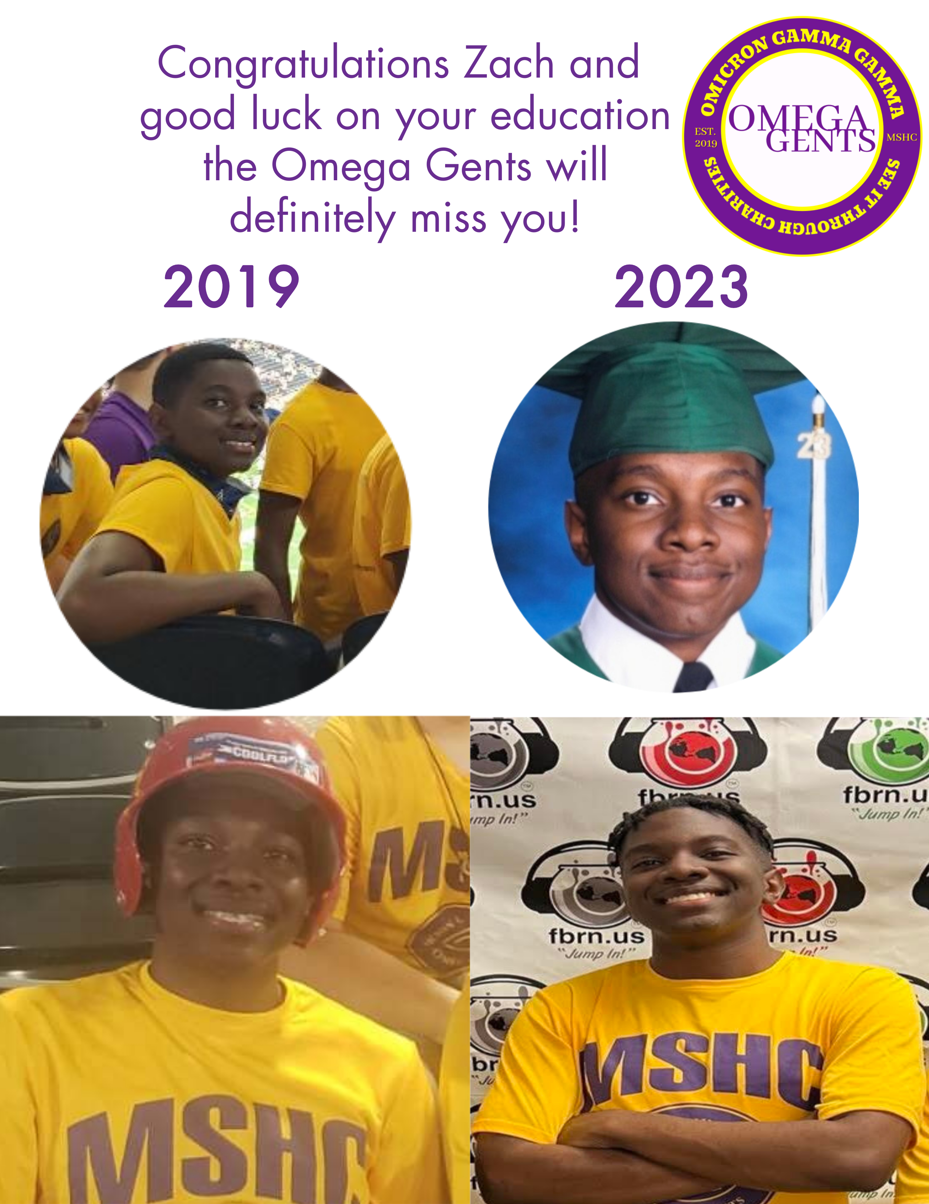

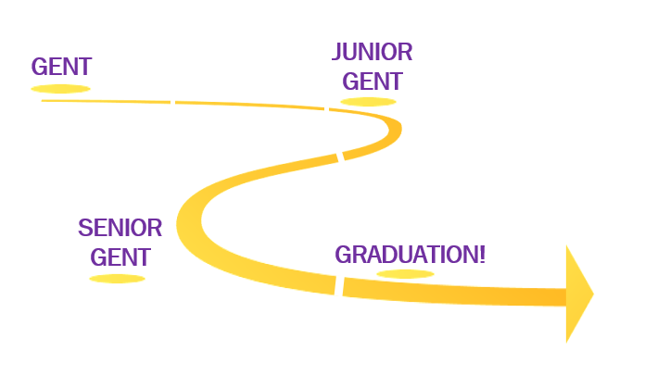
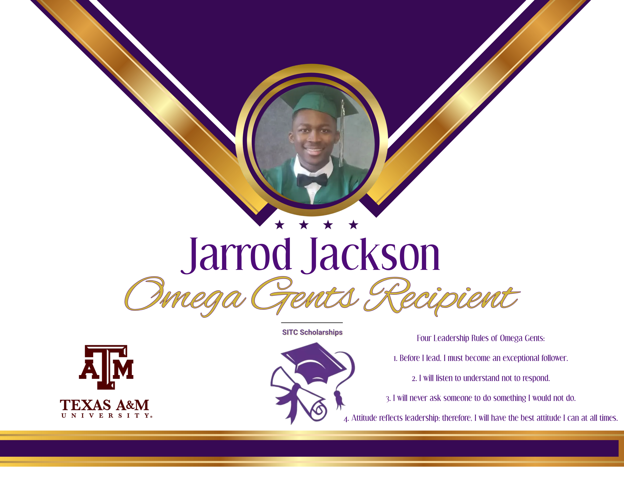
Roadmap from Gent to Graduation
The Omega Gents program welcomes young men between the ages of 10 and 15 as new participants, with no new entries accepted beyond age 15. However, once a member joins, he remains in the program beyond his 16th birthday. Participants continue their journey in Omega Gents until they graduate from high school, benefiting from ongoing mentorship and leadership development.
After Graduation, mentees carry forward the leadership values and skills they have developed throughout the program. The bond between mentor and mentee is expected to extend beyond the program, creating a lifelong relationship of guidance and support. As graduates pursue college and career opportunities, they stay connected to their mentors while giving back to future Omega Gents, ensuring the continued legacy of leadership
A Junior Gent has demonstrated emerging leadership abilities and applies the skills learned as a Gent. They continue to develop by taking on more responsibilities and learning how to mentor others. Their progress prepares them to transition into a Senior Gent.
A Senior Gent serves as a mentor to Junior Gents and Gents, guiding them through the program. They exemplify the highest standards of leadership and set an example for others to follow. At the end of this journey is Graduation, successfully completing the program after high school graduation.
A beginning mentee enters the Omega Gents program as a Gent, new to the program and eager to learn. During this stage, they focus on developing foundational leadership skills. Their goal is to grow and advance to the next level as a Junior Gent.

Slide 8
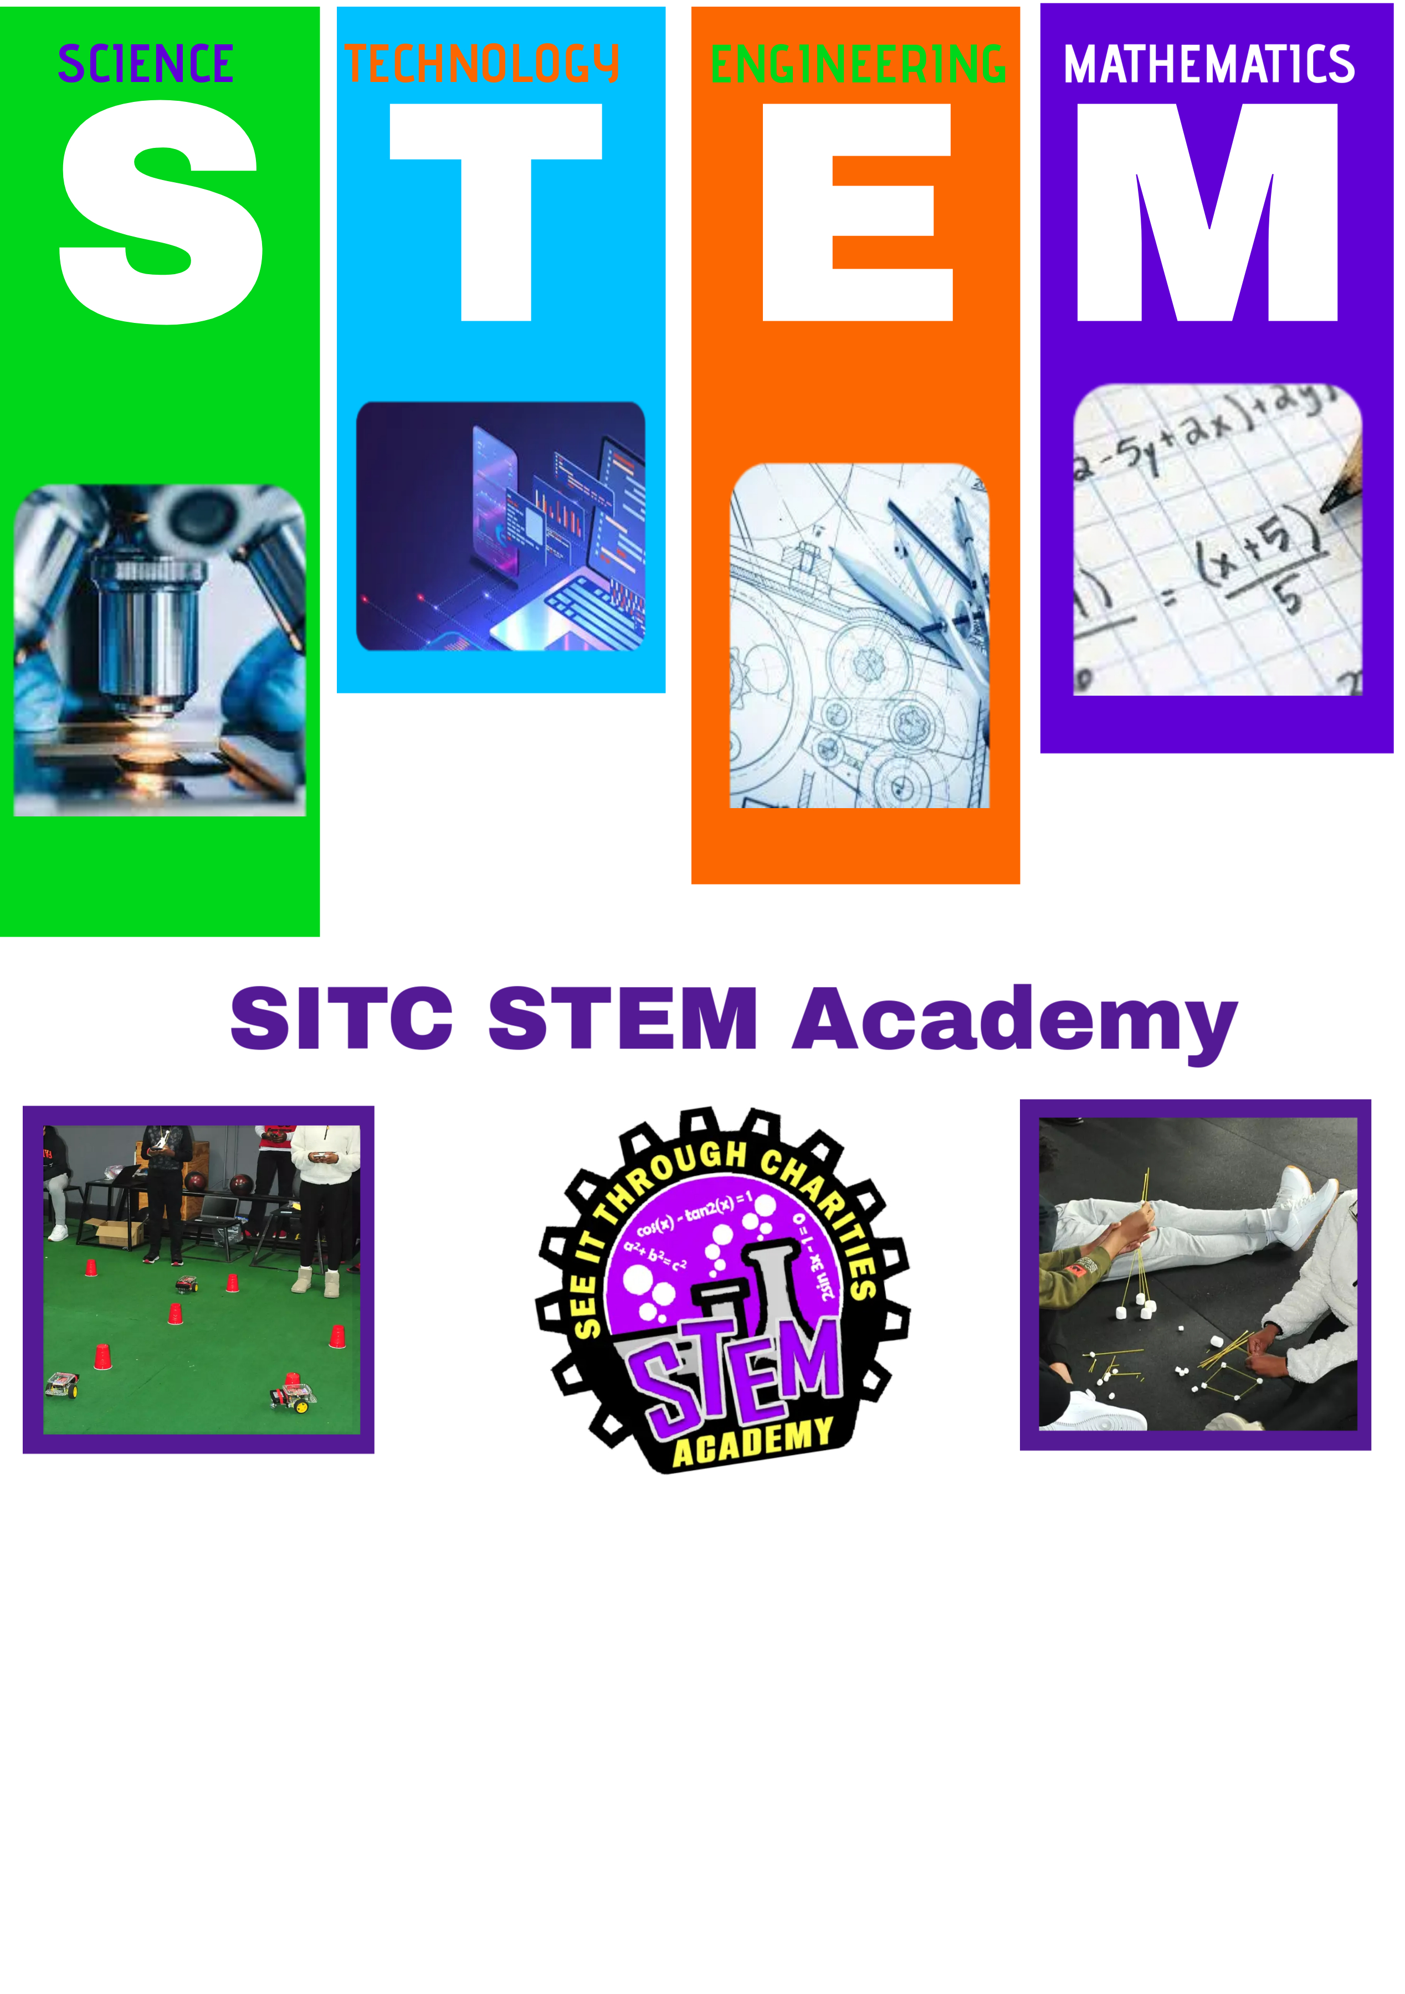
The SITC STEM Academy is designed for students ages 10 to 18, providing a structured curriculum in Science, Technology, Engineering, and Math (STEM). The program is crafted to engage students through hands-on learning, teamwork, and project-based applications to prepare them for careers in STEM fields.
Core Subject Areas
Science
Students will explore key scientific fields based on the most popular subjects studied globally. The curriculum includes:
Chemistry: Chemical reactions, periodic table, and lab experiments.
Physics: Laws of motion, energy, and electromagnetism.
Environmental Science: Climate change, sustainability.
Technology
Two 16-Week Robotics Program per calendar year.
Students will design, build, and program robots, learning:
Basics of robotics and mechanical design.
Programming with Python and C++
AI and machine learning fundamentals.
Participation in competitions and real-world challenges.
Animation & Coding Program
Students will develop skills in:
Animation: 2D and 3D animation, character design, and storytelling
Coding: Python, Java, and Scratch.
Game Development: Unity and Unreal Engine.
Engineering
Engineering lessons will introduce students to:
Mechanical Engineering: Design and building simple machines.
Civil Engineering: Bridge-building and structural analysis.
Electrical Engineering: Circuit design and microcontroller programming.
Aerospace Engineering: Principles of flight and drone technology.
Mathematics
The program emphasizes:
Algebra & Geometry: Equations, graphing, and problem-solving.
Statistics & Data Science: Probability, analysis, and visualization.
Financial Literacy: Budgeting, investing, and economic principles.

Slide 9
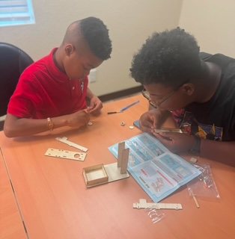
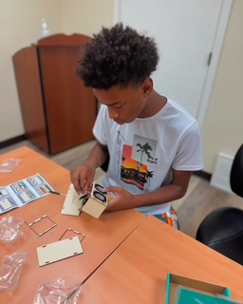
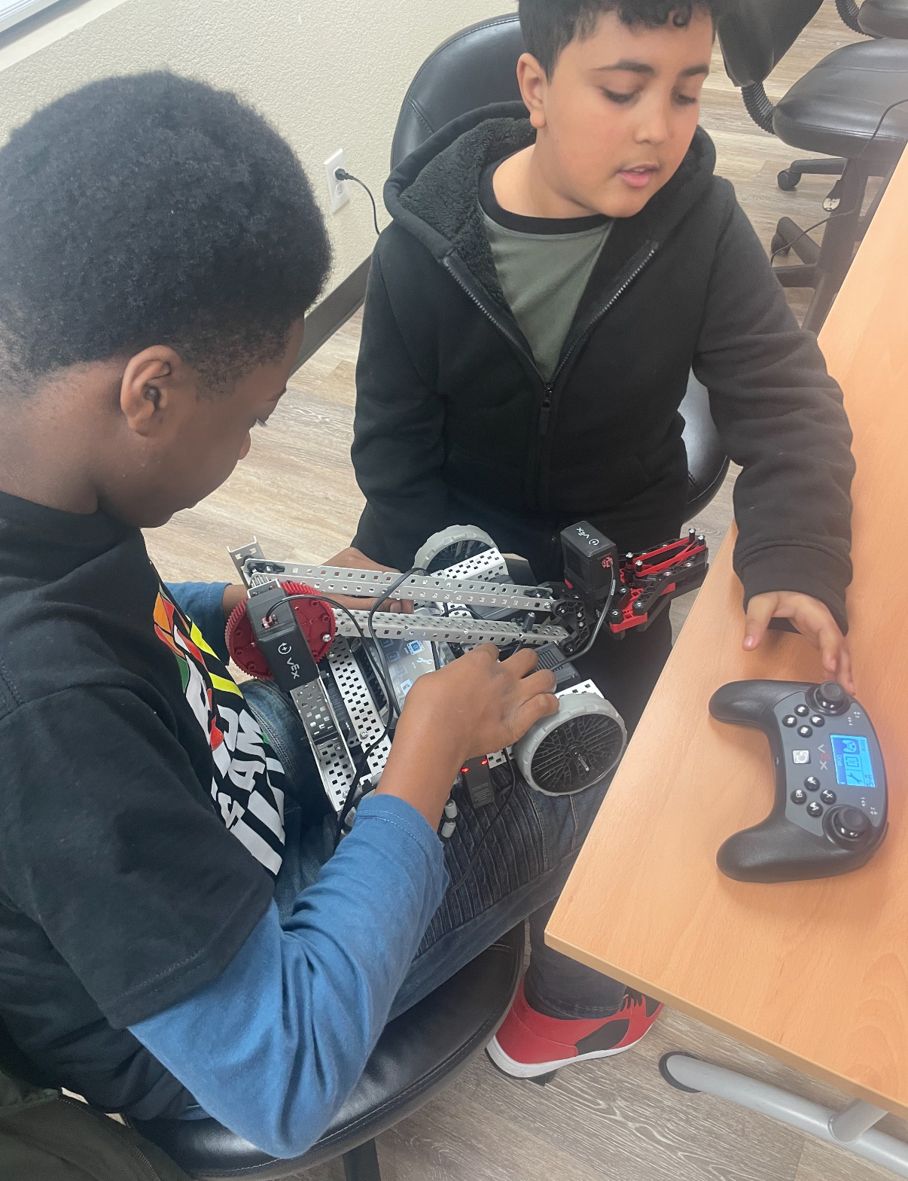
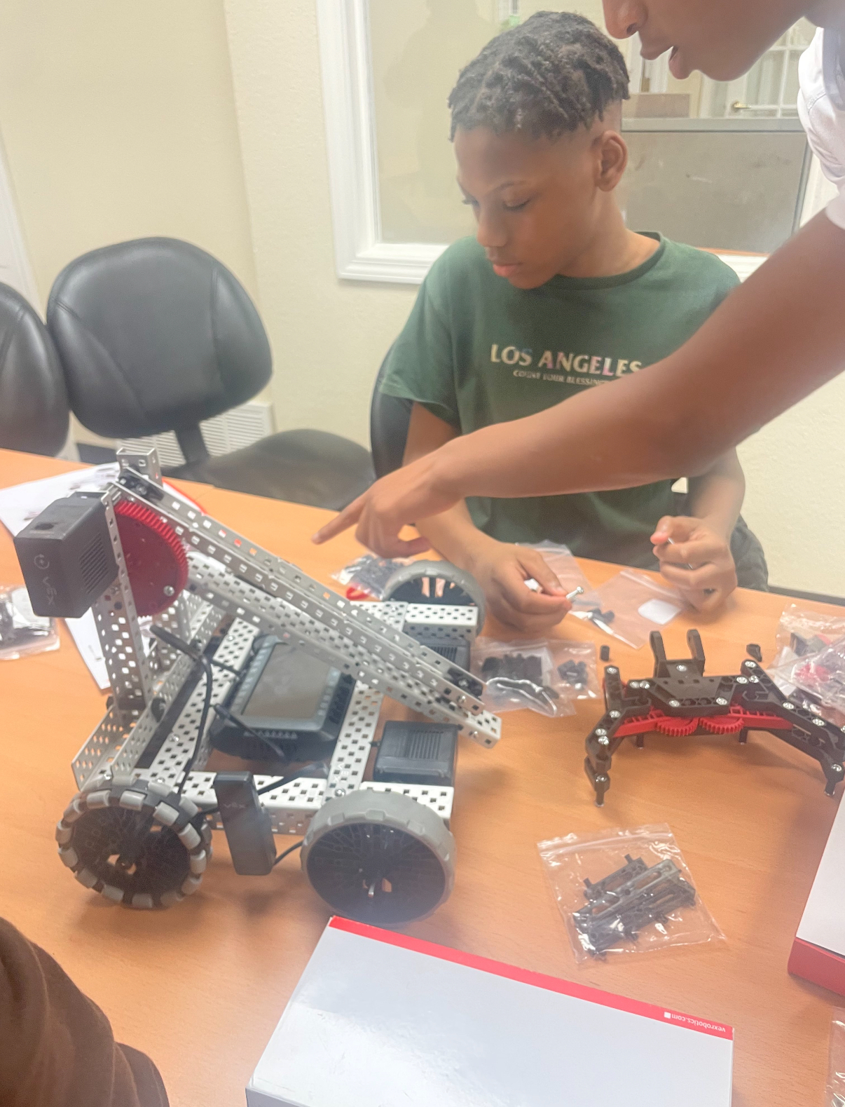
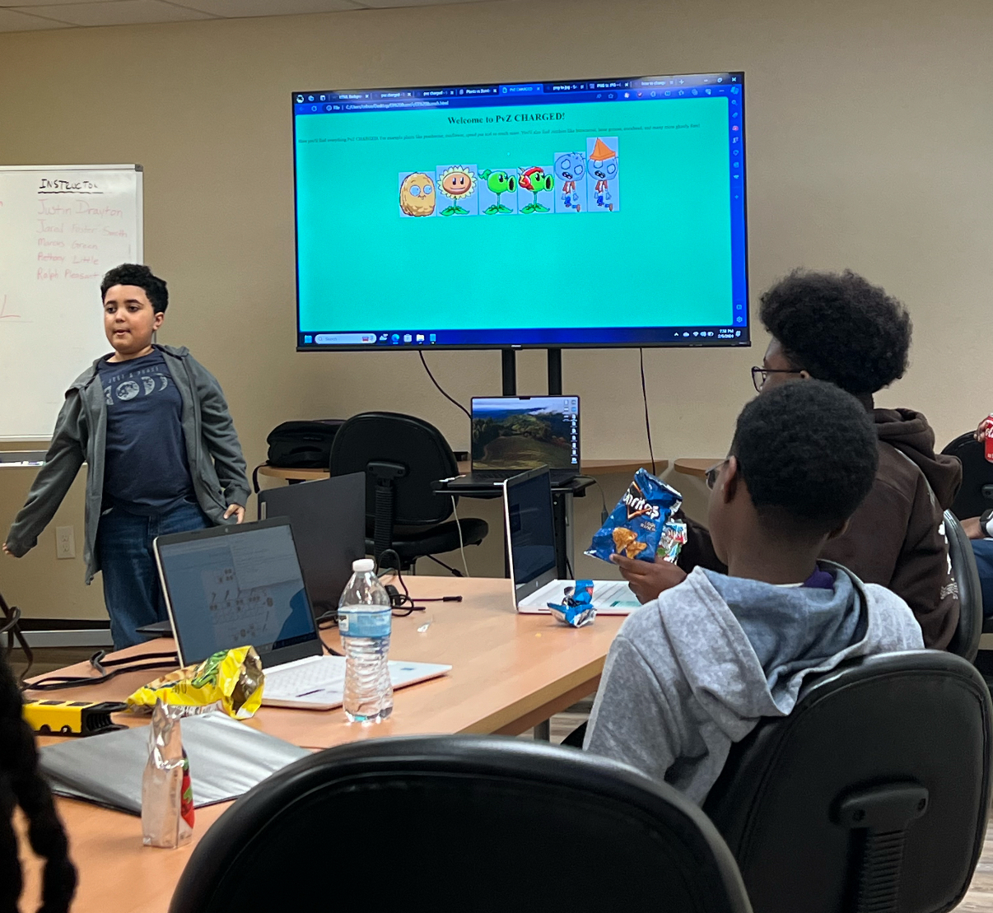
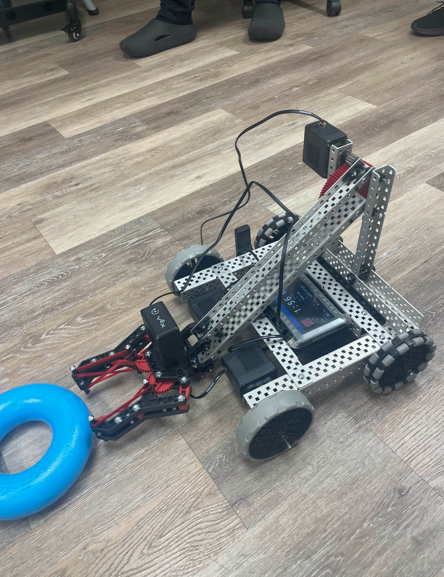
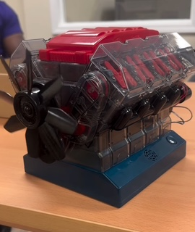
Operational Standard
Duration: Year-round with seasonal intensives.
Class Size: 15 students per session.
Instructors Per Subject:
O Science: 2 instructors.
O Technology: 3 instructors.
O Engineering: 2 instructors.
O Math: 2 instructors.
Code of Conduct
Students are expected to:
1.Show respect to instructors and peers.
2. Maintain a safe and inclusive environment.
3. Engage actively and responsibly in all activities.
4. Follow ethical practices in technology and scientific exploration.
5. Demonstrate teamwork and leadership in group projects.
Philosophy on Partnerships
Our program thrives on collaboration with schools, universities, businesses, and community organizations. By working together, we can provide mentorship, scholarships, and internship opportunities to students, ensuring their long-term success.
Funding & Sustainability
Funding will be secured through:
Grants & Sponsorships: Applications to educational and corporate grants.
Community Fundraising: Events, STEM fairs, and donor campaigns.
Corporate Partnerships: Collaborations with tech firms and engineering companies.
Tuition & Scholarships: Affordable fees with need-based scholarships.
By fostering innovation and curiosity, this program will empower the next generation of STEM leaders.

Slide 10
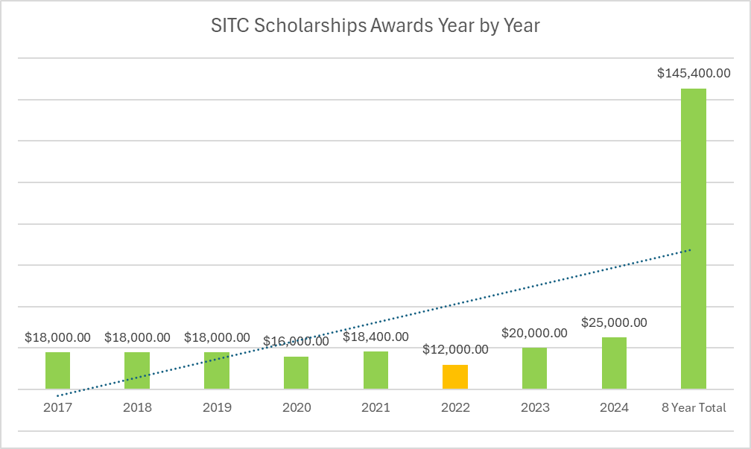
We recognize the importance of education as the foundation for future success. Since 2017, we have awarded a total of $145,400 in scholarship funds to students in Dallas-Fort Worth metropolitan area. We believe in uplifting students for their challenging work by rewarding them with our Calvin Golden, Eddie B. Freeman, Merit-based and Omega Gents scholarships.
Calvin Golden is a proud charter member of the Omicron Gamma Gamma Chapter of Omega Psi Phi Fraternity, Inc., has been a driving force since its inception. His unwavering dedication and commitment to the chapter have left a lasting impact, inspiring generations of brothers. In honor of his service, the chapter proudly voted to name all arbitrary scholarships after him. Now, every financial member with a graduating child will have the opportunity to receive this prestigious scholarship, ensuring his legacy of excellence continues for years to come!
Eddie B. Freeman was a man of great honor, a dedicated member of the Omicron Gamma Gamma Chapter of Omega Psi Phi Fraternity, Inc., and the third president of the See It Through Charities Foundation. Though he sadly passed away due to health challenges, his unwavering support for both the fraternity and the foundation continues to inspire. In his memory, a scholarship bearing his name is awarded to the highest-achieving applicant from our pool, ensuring his legacy of excellence and commitment lives on.
Each year, our Merit-based scholarship honors the top scholars in the Dallas-Fort Worth metropolitan area. From our pool of applicants, we select the brightest and most deserving students, recognizing their academic excellence and dedication. These outstanding graduating high school seniors are awarded funds to support their journey as incoming college freshmen.
Annually, we proudly celebrate our graduating Omega Gents by awarding them a scholarship. Their dedication and growth throughout the program deserve recognition, and we are honored to support their next steps. This scholarship serves as a reward for their commitment, and we want it to be a steppingstone toward their future success.
8

Slide 11

SITC Fundraising
We are committed to building a sustainable and thriving future for our organization by driving generosity, collaboration, and lasting impact. Through strategic fundraising, we actively expand our reach, launch transformative programs, and address critical community needs with transparency, innovation, and unwavering dedication. At the heart of our fundraising efforts are three powerful initiatives: the Omega Gents mentoring program, STEM Academy, and Scholarships. These pillars fuel our mission and ensure we continue making a meaningful difference in the lives of young men and future leaders.
Our biggest fundraising event, QSW: The Ultimate Weekend Experience, is a high-energy, purpose-driven celebration. The centerpiece of the weekend is QueSino Night, a thrilling, casino-themed event where participants compete for incredible donated prizes—without any real-money wagering. It's an unforgettable evening of gaming, music, and dancing, all in support of our cause.
The excitement begins on Friday with our Summer Styles and Stixx kickoff event. On Saturday, we take to the greens for a meaningful round of golf at the SITC Golf Tournament, leading up to the main event, QueSino Night. We conclude the weekend with a Sunday morning brunch, wrapping up a dynamic, mission-driven experience that fuels our ability to give back.
8

Slide 12
See It Through Charities, Inc
Organizational Overview & Program Initiatives Guide

